Slide 1

Power Forecasting of Solar PV Systems Using Recurrent Neural Network
PRESENTED BY:
Aniket
Mrigais Pandey
Dhananjay Jha
Harjit Singh
UNDER THE GUIDANCE OF:
Dr. Sunil D Rathod
DEPARTMENT OF COMPUTER ENGINEERING
Dr. D. Y. PATIL SCHOOL OF ENGINEERING
Dr . D. Y. PATIL TECHNICAL CAMPUS, PUNE-412105
SAVITRIBAI PHULE PUNE UNIVERSITY
2018-2019

Slide 2
Index
Introduction
Motivation
Literature Review
Problem Statement
Objectives/Scope
System Architecture
Algorithm
UML Diagrams
Result
Project Plan
Requirement Analysis
Feasibility
Conclusion
References

Slide 3
Introduction
Solar Power- Power obtained by harnessing the energy of the sun's rays.
Machine Learning- It is an application of Artificial Intelligence (AI) that provides systems the ability to automatically learn and improve from experience without being explicitly programmed. Machine learning focuses on the development of computer programs that can access data and use it learn for themselves.

Slide 4
Motivation(1)
Roof-top mounted solar photovoltaic (PV) systems are becoming an increasingly popular means of incorporating clean energy into the consumption profile of its users.
It is one of the most efficient renewable source of energy which can be used over non renewable sources of energy as Fossil Fuels.
There are certain influencing factors which promote the use of Solar Energy such as
Environment Friendly
Safer than traditional electric current.

Slide 5
Motivation(2)
The motivation behind taking up this project was to implement a model which would help people manage the energy resources in an efficient and economic way.
This model can help the user to pre-plan and use the power according to the prediction made by different machine learning and statistical techniques and avoid any sorts of loss due to sudden weather changes which are not in their control.
Application of this model incurs low cost for installation(economical), safer and comparatively more available than other energy resources.
Electric utilities often allow the inter-connection of such systems to the grid, compensating system owners for electricity production. As the systems grow in number and their contribution to the overall load profile becomes increasingly significant, it becomes imperative for utilities to accurately account for them while planning and forecasting generation.

Slide 6
Literature Review
PAPER NO. | PAPER NAME | ADVANTAGES | LIMITATIONS
1 | N. Sharma, P. Sharma, D. Irwin, and P. Shenoy, “Predicting solar generation from weather forecasts using machine learning.” | 27% more accurate than existing models. 51% better than simple approaches that only use the past to predict the future. | It does not incorporate information from multiple weather metrics and their impact on solar intensity.
2 | Gensler-Janosch, A., et al. “Deep Learning for solar power forecasting - An approach using AutoEncoder and LSTM Neural Networks.” | Performance achieved can also be transferred to other regenerative energy sources, e.g. forecasting of wind power output. Feature Extraction Capability. | It needs to take into account if an overestimation or an underestimation is preferred.
3 | Mayukh Samanta, Bharath Srikanth, Jayesh Yerrapragada, “Short Term Power Forecasting Of Solar PV Systems Using Machine Learning Techniques.” | High Accuracy using Hybrid Model. | Predicts a Non Zero Solar irradiance during period of day when there is completely no sunlight.

Slide 7
Problem Statement
To develop a system for accurately predicting the power forecasting of solar power for PV systems using RNN for a short period of time.
The system comprises of machine learning modules which will predict the power generation by solar pv systems by taking into consideration different meteorological and weather related parameters.

Slide 8
Objective/Scope
The main objective is to benchmark different forecasting techniques of solar PV panel energy output. Towards this end, machine learning and statistical techniques can be used to dynamically learn the relationship between different weather conditions and the energy output of PV systems.
This is being done to optimize the energy structure and improve the performance of a PV system.
Accurate prediction of PV power output is required to make better generation plans, support the spatial and temporal compensation, and achieve coordinated power control, so that the need for energy storage capacity and operating costs can be reduced.
Our aim is to investigate the future engineering methodologies, which can be used to increase the overall prediction accuracy.
We will be using various techniques to train models on solar irradiance data and different meteorological parameters to forecast solar irradiance, and therefore power, for different forecasting horizons in the short-term future.

Slide 9
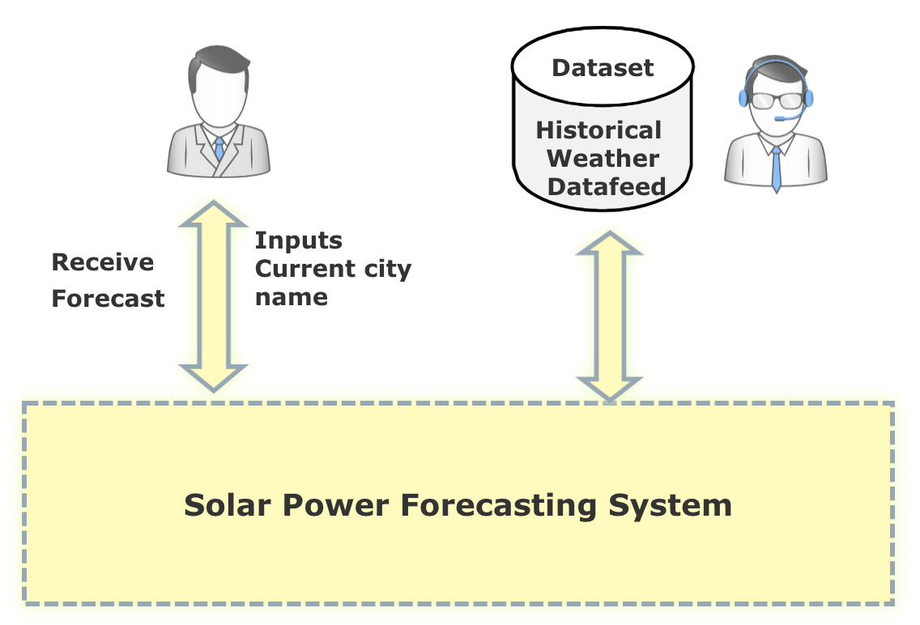
System Architecture

Slide 10
Algorithm
Recurrent Neural Network (RNN)
A Recurrent neural network (RNN) is a class of artificial neural network where connections between nodes form a directed graph along a temporal sequence. This allows it to exhibit temporal dynamic behavior. Unlike feedforward neural networks, RNNs can use their internal state (memory) to process sequences of inputs.
Therefore a Recurrent Neural Network has two inputs, the present and the recent past. This is important because the sequence of data contains crucial information about what is coming next, which is why a RNN can do things other algorithms can’t.

Slide 11
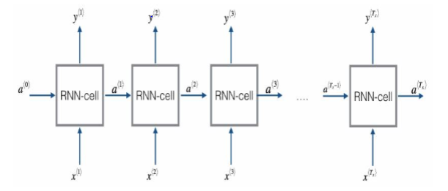
RNN Working
The prediction learning method implemented is an LSTM (Long Short Term Memory) recurrent neural network. We have assumed that a recurrent neural network is capable of capturing time-dependent trends in the data because feedback loops enable RNN’s to exhibit memorization of temporal behaviour. Developing the Recurrent Neural Network involved sampling performance on the basis of a wide range of modifiable parameters which includes the size and number of hidden layers, types of activation functions(Tanh, ReLu), type of optimization (Adam) and regularization, batch, epoch sizes, and K Fold Cross-Validation methods.

Slide 12
Long-Short Term Memory(LSTM)
Long Short-Term Memory (LSTM) networks are an extension for recurrent neural networks, which basically extends their memory. Therefore it is well suited to learn from important experiences that have very long time lags in between.
The units of an LSTM are used as building units for the layers of a RNN, which is then often called an LSTM network.
LSTM’s enable RNN’s to remember their inputs over a long period of time. This is because LSTM’s contain their information in a memory, that is much like the memory of a computer because the LSTM can read, write and delete information from its memory.

Slide 13
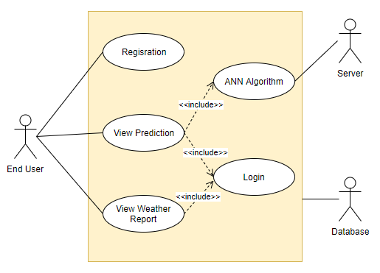
UML Diagrams(1)
USE CASE

Slide 14
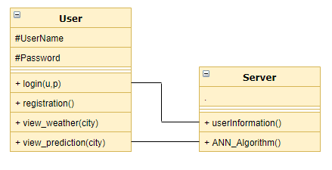
UML Diagrams(2)
CLASS DIAGRAM

Slide 15
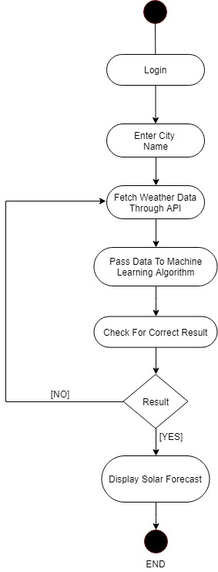
UML Diagrams(3)
DATA FLOW DIAGRAM

Slide 16
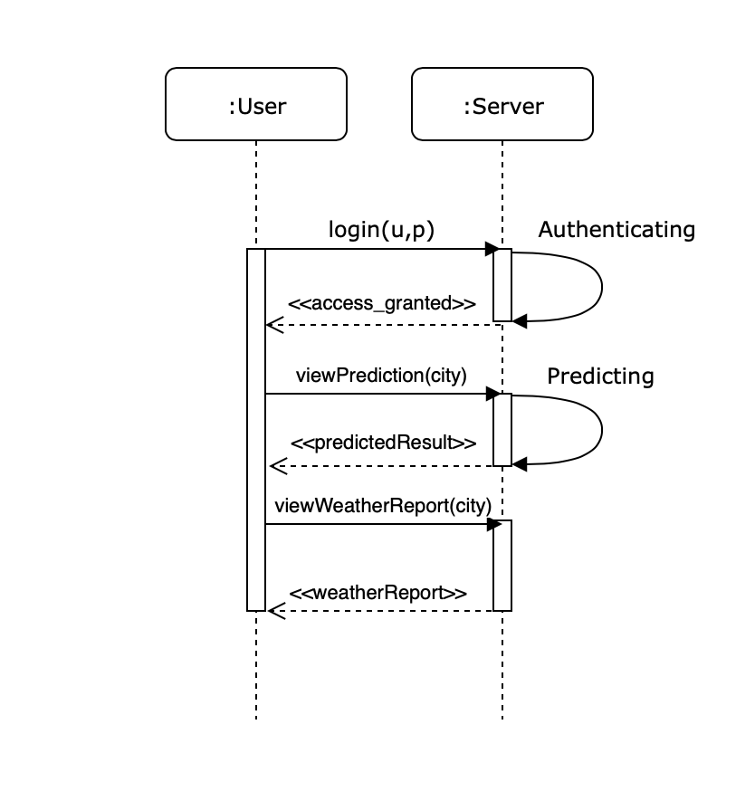
UML Diagrams(4)
ACTIVITY DIAGRAM

Slide 17
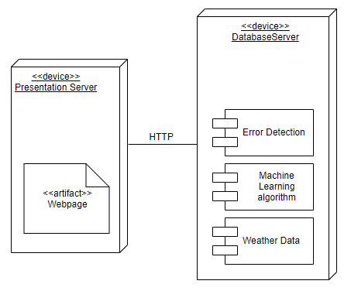
UML Diagrams(5)
DEPLOYMENT DIAGRAM

Slide 18
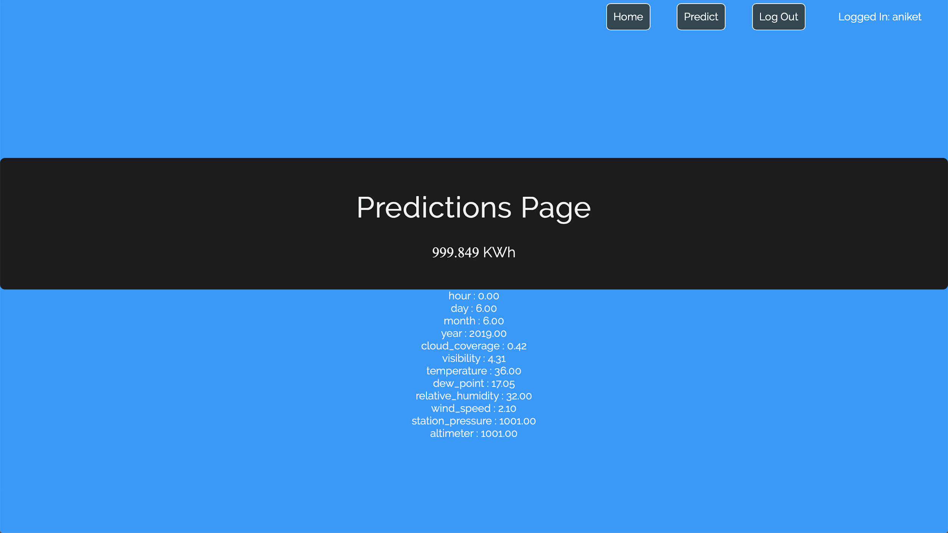
Results(1)
Prediction Page Result

Slide 19

Results(2)
City Name Selection

Slide 20

Results(3)
Login

Slide 21
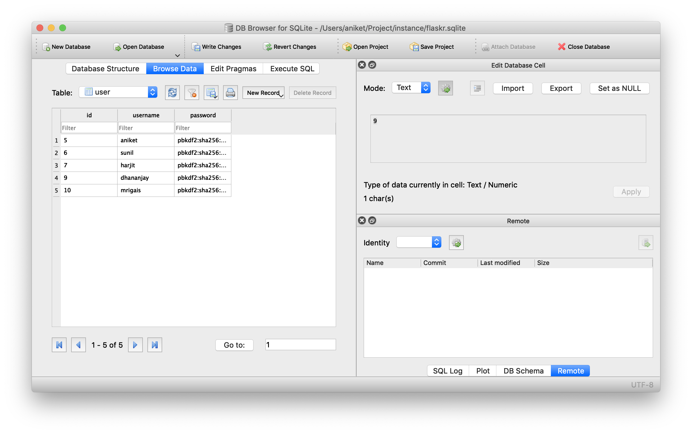
Results(4)
Database

Slide 22
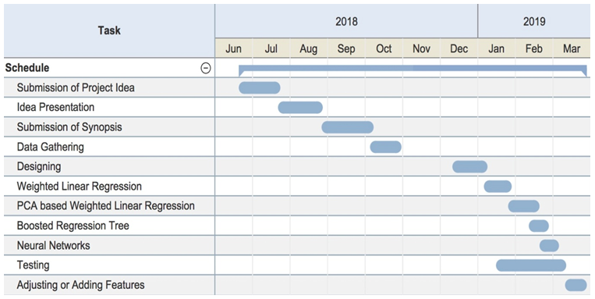
Project Plan

Slide 23
Requirement Analysis(1)
Hardware Requirement:
RAM- 8GB
Processor- i3 or Higher
Hard Disk- 500GB
Software Requirement:
Anaconda 5.2
Python 3.6
HTML
openweathermap.org and darksky.net API
Flask Server

Slide 24
Requirement Analysis(2)
Software Requirements:
All the software required are “Open Source”
Dataset Requirements:
The solar energy output necessary to power the campus of the University of Illinois in Urbana-Champaign was obtained from publicly-available repository.
The weather data used in this work is historical weather data from Amherst, MA, and is maintained by the University of Massachusetts, Amherst – Computer Science Weather Station.

Slide 25
Feasibility
MARKET FEASIBILITY :
As there is no such device or model for Solar Power prediction, consequently this proposed system can be very useful for various Industrial and Residential sector.
TECHNICAL FEASIBILITY:
It is possible to develop the system as software resources used are fully open-source.
FINANCIAL FEASIBILITY :
The project is financially feasible as it can be completed in less resources and almost no capita.

Slide 26
Conclusion
This model will help user predict the Solar Power Generation. It will also guide the user through unfamiliar situation which can occur so that he could save power prior itself. It will also help in promoting use of renewable source of energy.
With the use of it along with Solar Power Forecast, Weather report for upcoming days can also be viewed.

Slide 27
References
IEEE Papers
N. Sharma, P. Sharma, D. Irwin, and P. Shenoy, “Predicting solar generation from weather forecasts using machine learning,” in Smart Grid Communications (SmartGridComm), 2011 IEEE International Conference on, pp. 528–533, IEEE, 2011.
Gensler-Janosch, A., et al. “Deep Learning for solar power forecasting — An approach using AutoEncoder and LSTM Neural Networks.” 2016 IEEE International Conference on Systems, Man, and Cybernetics (SMC), 2016
Mayukh Samanta, Bharath Srikanth, Jayesh Yerrapragada, “Short Term Power Forecasting Of Solar PV Systems Using Machine Learning Techniques.”
http://s35695.mini.alsoenergy.com/Dashboard/2a5669735065572f4a42454b772b714d3d

Slide 28
Presentation By:
Aniket
Dhananjay Jha
Harjit Singh
Mrigais Pandey

